Slide 1

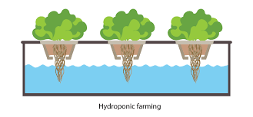
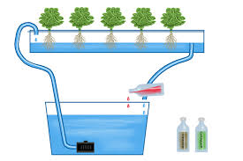
OPTIMISATION (DESIGN AND CONSTRUCTION) AND TESTING OF IOT BASED NFT HYDRPONICS SYSTEM
BY-
PUSHPAK SINGH-(25)
HARSH-(32)
AKASH KR. SINHA-(41)
ABHISHEK SATAPATHI-(45)
SUPERVISORS:-
1. Prof. Rimjhim Majumdar
2. Prof. (Dr.) Rahul Baidya

Slide 2
Table Of Content
The problem statement
Need for solution
Introduction to Hydroponics
Advantages
Comparison between tradition agriculture and Hydroponic farm
Methodology
Iot(Internet of things)
Sensors and Components used
Experimental Setup(Cad model and Working model)
Energy Consumption and its cost per month.
Pert Chart of Activities
Cost Estimation
Future Scope

Slide 3
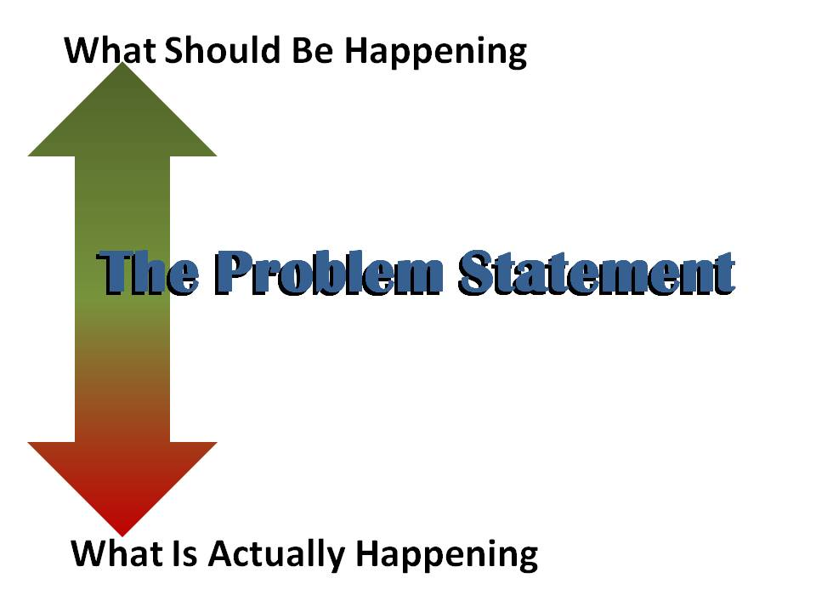
The Problem statement
Even though agriculture has been the source of nutrition since a very a long time, in the past few decades its quality (of nutrition) has been degraded with accusations of depleting natural resources. As the world's population is expected to be about 9.8 billion people by 2050, it stares at increasing food production by at least 70 per cent. However, the production is affected by many factors like –
Drought conditions and unpredictable weather.
Poor water management.
Raising temperature.
Lack of arable lands available to grow the crops.
Lack of irrigation.
Under – nourished crops.
So the solution is Hydroponic Farming!!

Slide 4


Need for solution
As a result ,people structured to use different methods of farming to reduce water consumption and space for farming.
One of the most famous methods is hydroponics farming. In recent research and studies by scientists worldwide have proved its usefulness.
The hydroponics system can be developed to solve the problems that affect the plant growth by controlling all the parameters automatically (using IoT), which made it possible to make an indoor farming without large space of land.

Slide 5
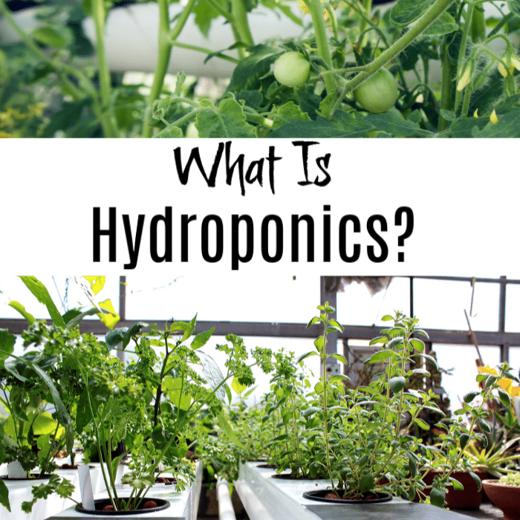
Introduction To Hydroponics
Hydroponics is the methodology of soil – less cultivation.
It is the method of growing plants using material nutrients solution dissolved in water ,without soil.
Utilizing this technology ,the root absorb balanced nutrient dissolved in water that meets all the plant developmental requirements.

Slide 6

Advantages
No soil is needed for hydroponics.
The water stays in the system and can be reused.
It is possible to control the nutrition level accurately.
Through IoT platform, the designed system is capable of maintaining healthy parameters for the plants.
Plants are healthier and reach maturity faster.
Production in off season possible when market prices are highest.

Slide 7
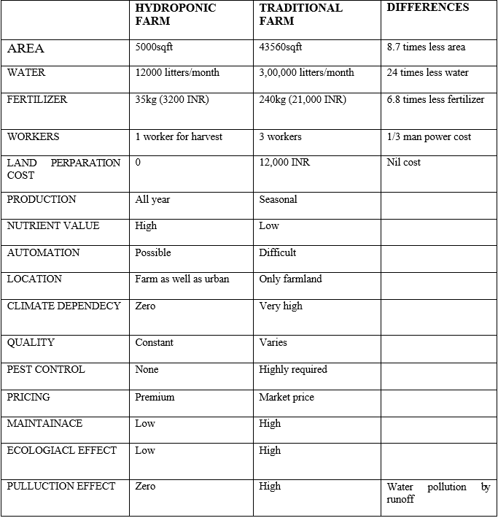
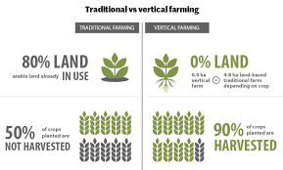
Comparison between tradition agriculture and Hydroponic farm

Slide 8
METHODOLOGY
This IoT based hydroponic system can be divided into two parts. The first part is an automatically control system used to continuously regulate two important elements in the solution of an IoT based hydroponic system. Those two elements are pH value and EC value (nutrient concentration). The values are continuously being sensed by their respective sensor to maintain the nutrient solution in the right condition for growth of the plant. The second part of the system is where the technology of IoT comes into play. With the special features of ESP32 microcontroller, the data from four sensors (pH, EC, temperature and flow rate) can always be monitored on the blink application.

Slide 9

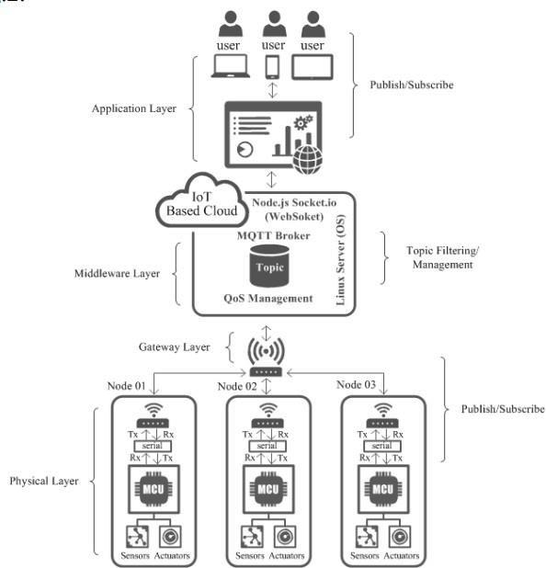
Internet of things (IOT) Platforms –
Internet of Things (IoT) is a network that connect things to internet network for communicate or exchange data or information via sensing devices with protocol that agreed. As for topology that used in this system can be seen in the fig bellow. In the NFT Hydroponic systems, Several parameters such as pH level of water, nutrients contained in water, temperature and humidity can be monitored using this IoT platform.

Slide 10
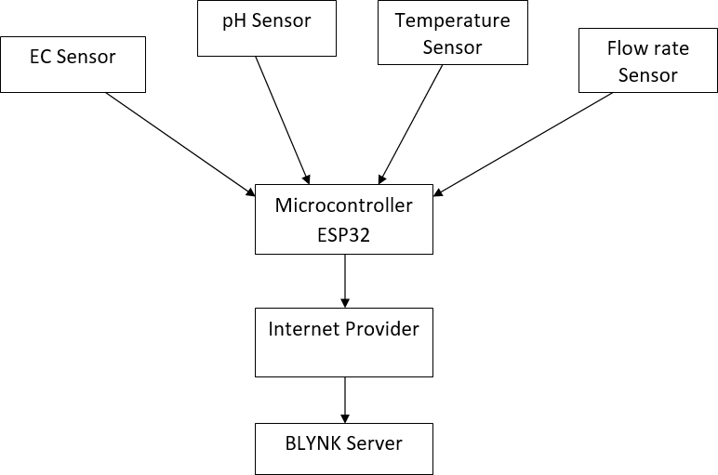
ESP32 Microcontroller

Slide 11
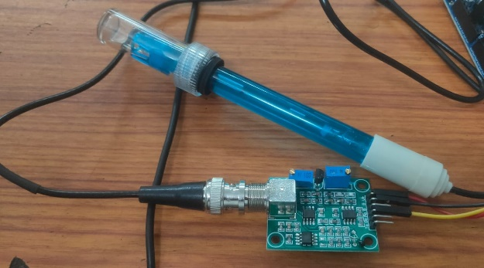
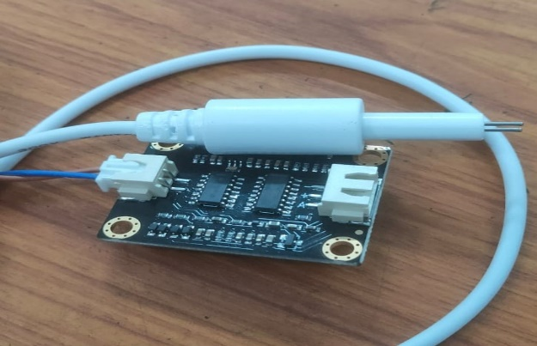
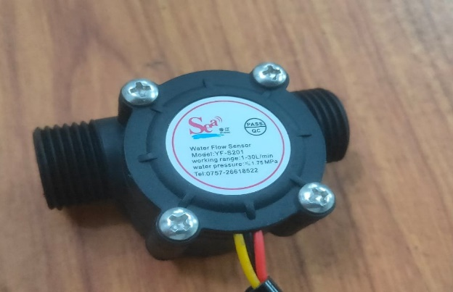
Sensors and Components of IoT used in Hydroponic
PH sensor
EC sensor
Water Flow Sensors

Slide 12
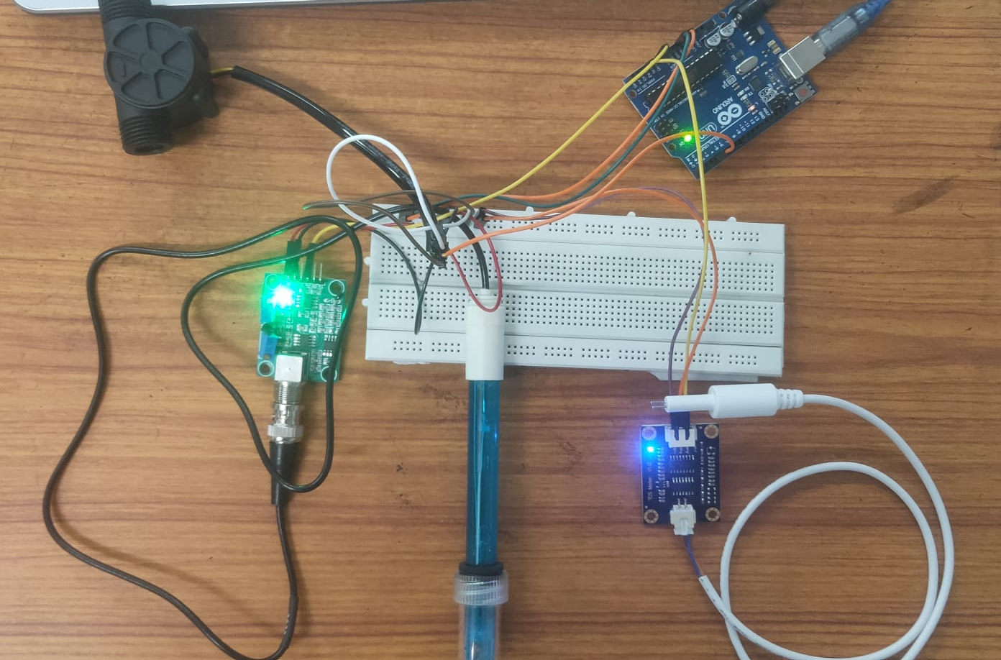
circuit setup

Slide 13
ENERGY CONSUMPTION AND ITS COST PER MONTH
Power consumed by pump = 24Watt
Now the Energy consumption in 24 hours = 24*24 Watt Hour
Now the Energy consumption in 30 Days = 24*24*30 Watt Hour
Total Consumption in Kwh = 17.28 Kwh
Total Consumption in unit = 17.28 units
In Kolkata the price per unit ranges from Rs 4.89 to Rs 8.92
Therefore by using maximum price it will cost Rs 154 per month.

Slide 14
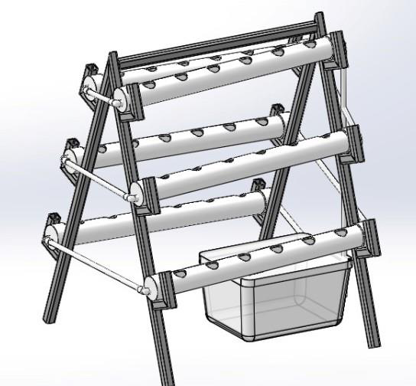
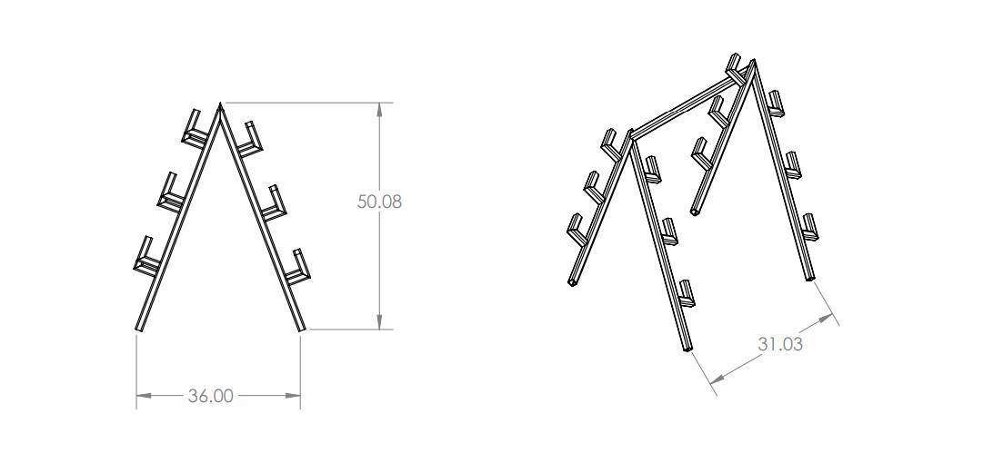
EXPERIMENTAL SETUP(Cad Model of NFT based Hydroponic system )

Slide 15
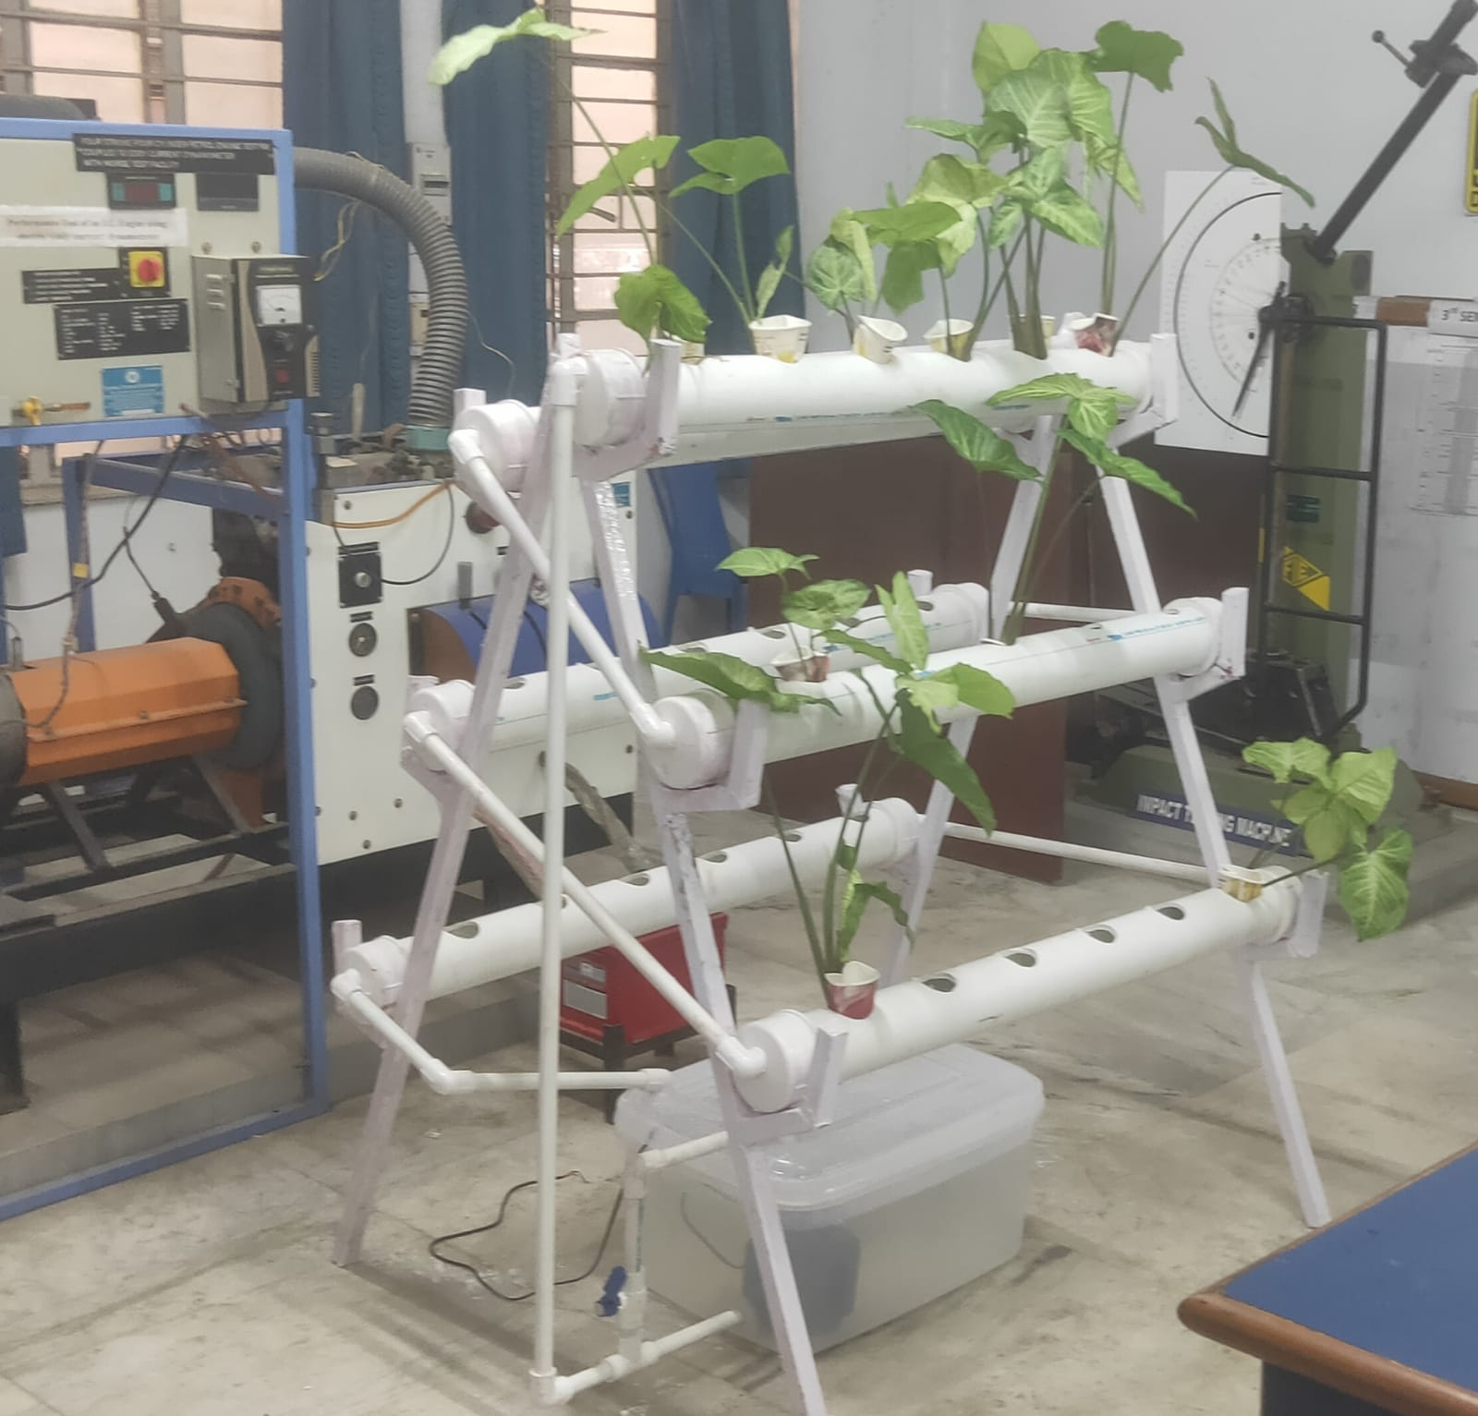
working model (EXPERIMENTAL SETUP)

Slide 16
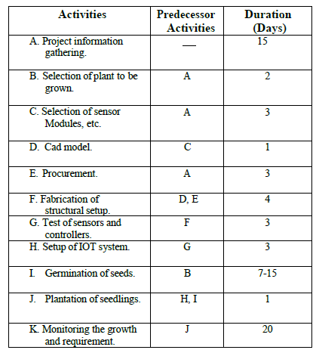
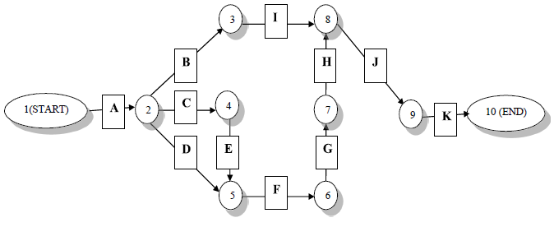
PERT CHART OF ACTIVITIES

Slide 17
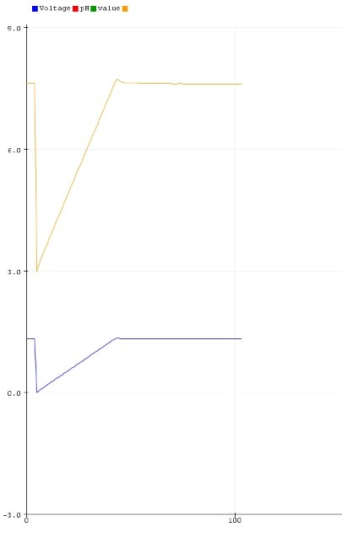
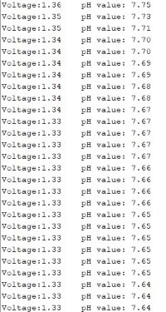
Result of ph sensor

Slide 18
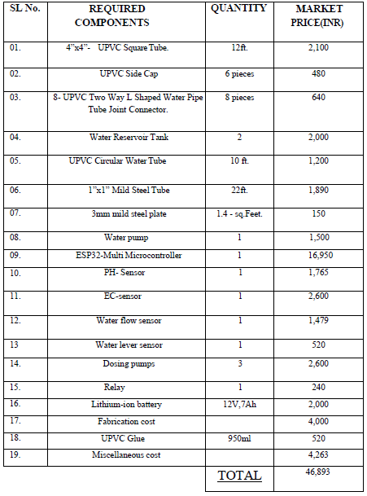

COST ESTIMAION For 1SEtup

Slide 19
FUTURE SCOPE
With the use of Automation we can reduce the human intervention and energy consumption.

Slide 20


